Slide 1
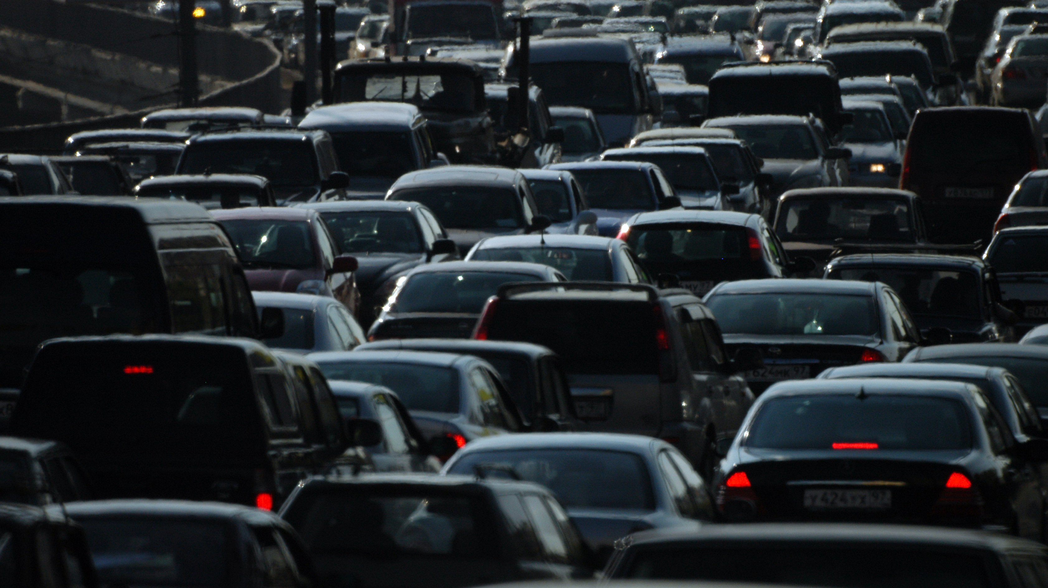
Used cars price prediction
Prudvi Siddanathi
Bhanu Anish Akkineni
Aanathi Mosali

Slide 2
Introduction
In this endeavor, we set out on a quest to harness the power of data science methodologies in order to construct resilient models for predicting the purchase price of pre-owned vehicles.
This project leverages historical used car price data and advanced machine learning algorithms to gain previously elusive insights into the complex world of used car pricing, providing a better prices.

Slide 3
Problem Statement
Getting a better deal while purchasing a used car is a critical problem that looms large over the automotive market.
The objective of this project is to utilize data science methodologies to enhance used car price prediction which involves usage of historical data, machine learning algorithms, helping the creation of robust models to aid in achieving the optimal price for a given used car.

Slide 4
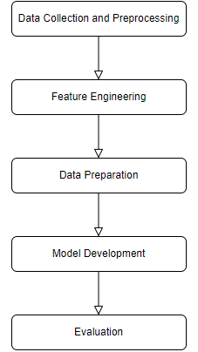
Methodology

Slide 5
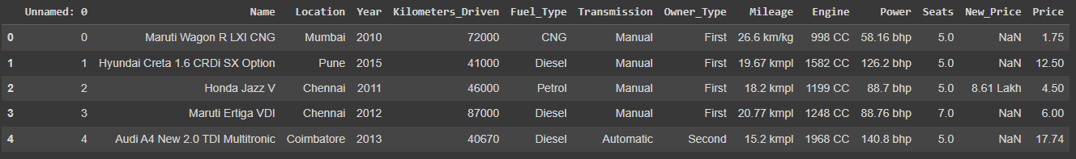
DAtaset
Size : 6019 entries

Slide 6
Data Collection and Preprocessing
Data is extracted from Car 24 (sourced from Kaggle), a prominent online marketplace for used cars, renowned for its wealth of data.
Preprocessing is undertaken, which involves addressing missing data, handling outliers, and standardizing the data which provides a robust dataset.

Slide 7
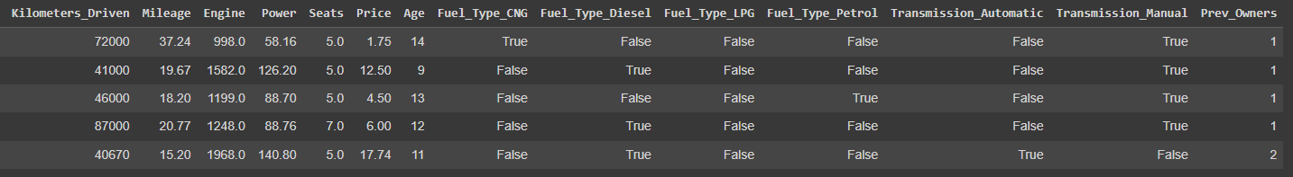
Data Collection and Preprocessing

Slide 8
Methods
Linear Regression
SVM
Random Forest
Decision Trees
XGBoost

Slide 9
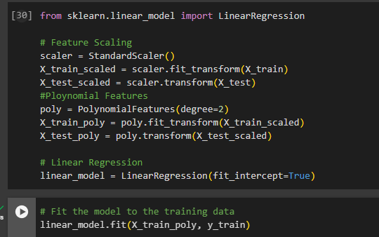
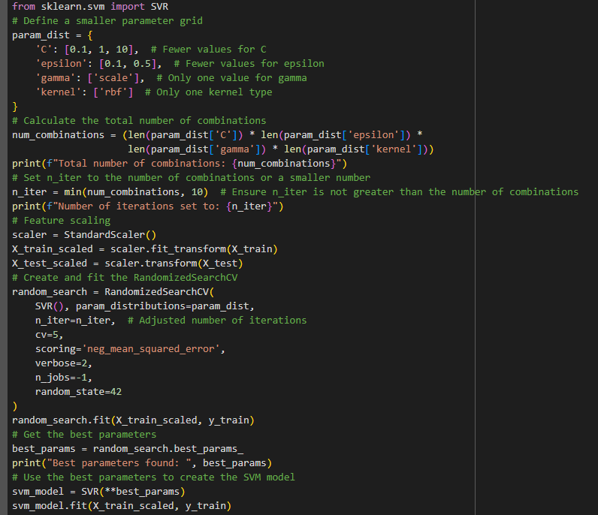
Methods
Linear Regression
SVM

Slide 10
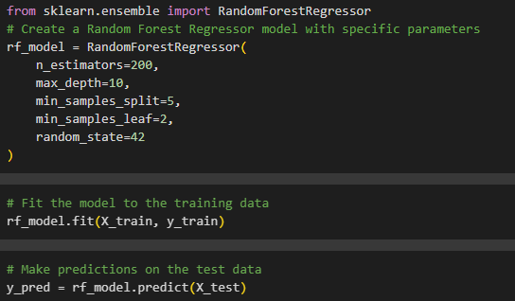
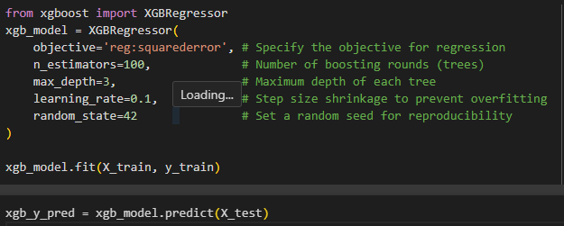
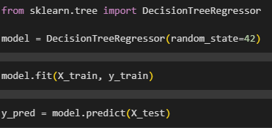
Methods
Random Forest
Decision Tree
XG Boost

Slide 11
Model Evaluation
We subject the Linear Regression, SVM, Decision Trees, Random Forest and XGBoost models to thorough assessment, employing metrics such as Mean Squared Error, Root Mean Square Error and R Squared Score.

Slide 12
results

Slide 13
Challenges
Domain Knowledge – Research
Deriving useful features – Data Preprocessing
Fine Tuning
Resource Limitation

Slide 14
REFERENCES
[1] Nabarun Pal, P. A. (2018). How much is my car worth? A methodology for predicting used cars prices using Random Forest. Future of Information and Communications Conference (FICC) 2018 , 1-6.
[2] Noor, K., & Jan, S. (2017). Vehicle Price Prediction System using Machine Learning Techniques. International Journal of Computer Applications, 27-31.
[3] Monburinon, N., Chertchom, P., Kaewkiriya, T., Rungpheung, S., Buya, S., & Boonpou, P. (2018). Prediction of Prices for Used Car by Using Regression Models. 5th International Conference on Business and Industrial Research (ICBIR), (pp. 115-119). Bangkok.
[4] Chen, Tianqi & Guestrin, Carlos. (2016). XGBoost: A Scalable Tree Boosting System. 785-794. 10.1145/2939672.2939785.
[5] Dataset: https://www.kaggle.com/datasets/avikasliwal/used-cars-price-prediction?select=train-data.csv
[6] Collab Link: https://colab.research.google.com/drive/1RGhpuRDEFa7ge4jRe_GJOK6t_BLax4Xr?usp=sharing

Slide 15
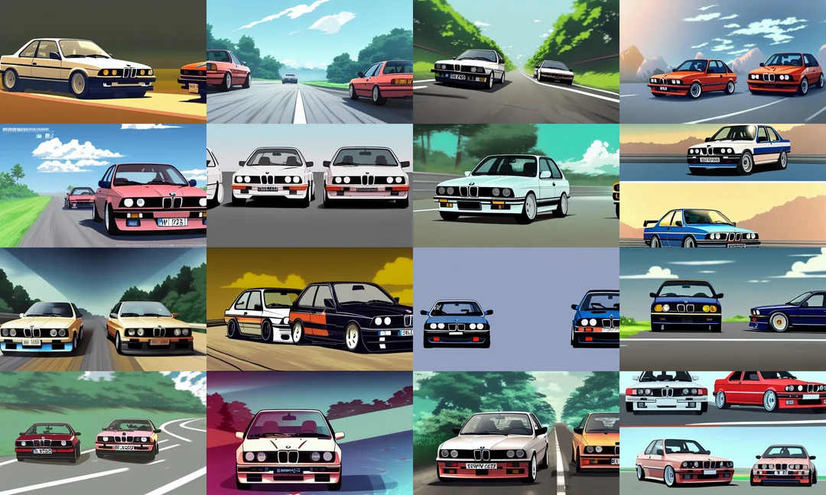
Thank you

